Slide 1
zekeLabs Kafka - Producers
Learning made Simpler ! www.zekeLabs.com

Slide 2
Overview
Constructing a Kafka Producer
Sending Message Synchronously
Sending Message Asynchronously
Configuring Producers
Serializers
Custom Serializers
Serializing with Avro
Partitions
Agenda

Slide 3
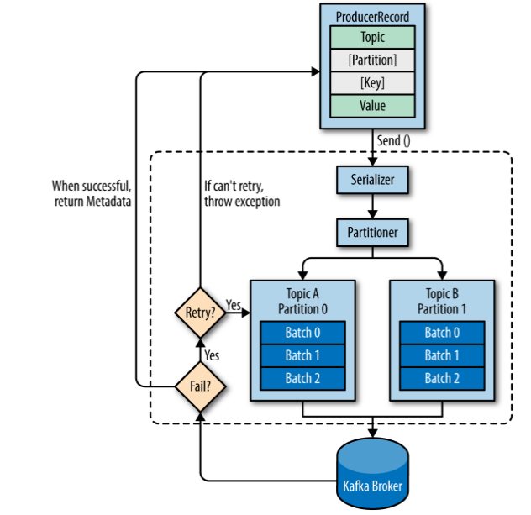
Overview

Slide 4
Steps
Application starts producing messages by creating ProducerRecord.
ProducerRecord should have topic information.
Optional parameters are key/partition.
Serialization of Key/Value
Data sent to partitioner. If we specify a partition, partitioner simply returns that.
Otherwise, partitioner will return key based on ProducerRecord key.
Once partition is selected, data is batched to per topic per partition queue.
Seperate thread is responsible for sending those messages
When broker receives the message, it sends back the response of type RecordMetadata (topic, partition, offset)
Error if failed.

Slide 5
Constructing a Kafka Producer
bootstrap.servers - host:port where the producers will establish initial connection, the list doesn't include all broker. Only ones for initial connections.
key.serializer
value.serializer

Slide 6
Methods of sending message
Fire-and-forget - Send message & don't really care if message has really reached.
Synchronous send - we use get() to wait on the future and see if the send() was successful or not.
Asynchronous send - call the send() method with a callback function, which gets triggered when it receives a response from the Kafka broker.

Slide 7
Configuring Producers
acks - 0,1, all
compression.type
retries
batch.size
linger.ms
client.id
max.in.flight.requests.per.connection
max.request.size

Slide 8
Serializers
Key neess to be serialized
Value can be serialized
Using custom partitioner, all the data can be sent to custom partitioner

Slide 9
Thank You !!!

Slide 10
THANK YOU
Let us know how can we help your organization to Upskill the employees to stay updated in the ever-evolving IT Industry.
Get in touch:
www.zekeLabs.com | +91-8095465880 | info@zekeLabs.com
Visit : www.zekeLabs.com for more details

